Slide 1
ReST APIs
Cross Platform
Sharable Architecture
Dave Hammers
September 11, 2017

Slide 2
Goals
Why am I standing here ?
What is my goal?
Describe a cross company approach to ReST APIs
Convince you to:
Develop ReST APIs across all products
Design Top down API client view
Use the same industry YANG models for ReST
RESTCONF (RFC8040)
Telemetry push instead of pull
Use Generated infrastructure
Use Automated test framework
Top 10 Format

Slide 3
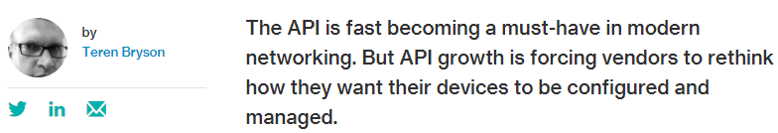
1. Start
Just a few years ago, APIs were something of a white rhino in the network engineering world.
… companies are now asking about (automation) concepts as they make purchasing decisions.

Slide 4



2. Simple
Fabric
Exposing every dial, knob becomes
“(SEP) Somebody Else’s Problem”(Douglas Adams)
Here’s all the data, let the client figure it out
Top Down vs bottom up.
The API: simplify and standardize client access
Simple representations like on/off
Or Small, Medium, Large
Simple is actually hard
Customers want our expertise
Cool stuff is done under the hood on the device
“The client needs to…” Asking the client is the last option
or

Slide 5



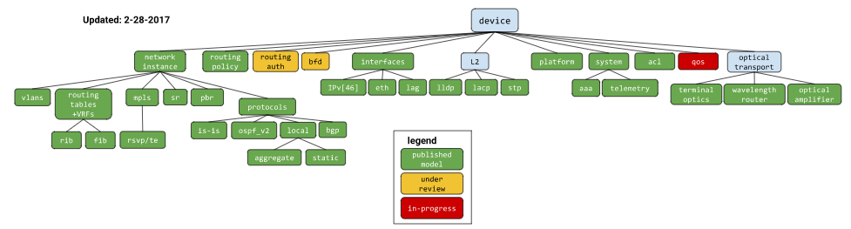
3. Standardize
Enterprise ReST APIs are the Wild West (make it up on the fly)
Adopt Industry YANG Models
YANG: 1) OpenConfig, 2) IETF/IEEE, 3) Brocade, 4) Extreme
RESTCONF (RFC 8040) ReST protocol
RESTCONF/YANG for all device mgmt:
Clients: local GUI, customer automation
Otherwise client code looks like this for every feature:
{
if EXOS
else if VOSS
else if BOSS
else if Fastpath
else if SLX
else if WiNG
else if Identify
else if NSE
}
OpenConfig YANG Model Tree

Slide 6
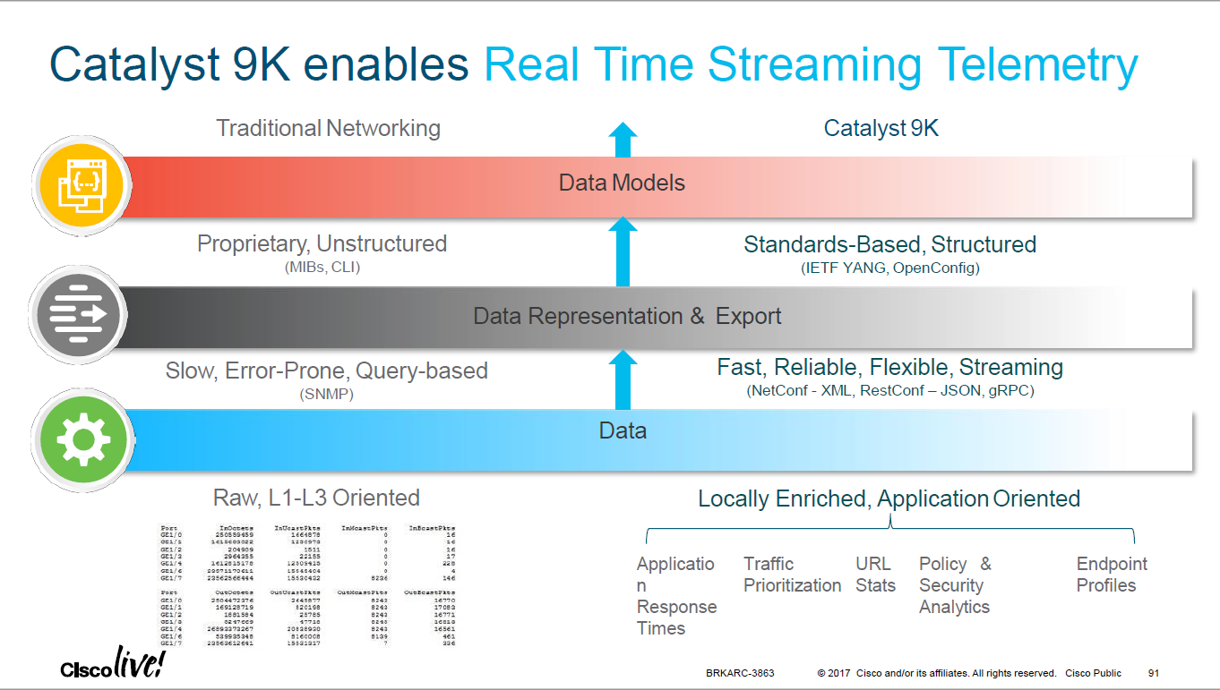

4. $ellable
Industry leaders behind OpenConfig
Automation with industry models. Same across Extreme Portfolio
Single customer experience
FUD answer:
Uniform API across Extreme Product line
Buy your favorite device.
Same management

Slide 7



5. Solutions
Common language for all Extreme Products
Unify Extreme interop with OpenConfig/RESTCONF
Single customer experience
Attract SW vendors
All products: same API
YANG/RESTCONF
Open
Config
Open
Config
YANG/RESTCONF
WiNG
NSE
EXOS
VOSS
SLX
Fastpath

Slide 8
6. Scalable
Push: Telemetry model
Client request periodic updates
No client side “response time” polling bottleneck
Push YANG defined data groups
EMC/client automation supports more devices when collecting

Slide 9
7. Serviceable
Single file to manage: python API bundle
Upgrades API, not OS
Client downloadable:
APIs stay in sync with client
OS functionality must already be available
Bundle with OS: customers with applications/automation
Customer automation

Slide 10
8. Sharable
Generated: YANG in:Code/docs/test out
platform independent python code framework
documentation – shows end user “how to”
test framework – TDD cross platform testing ensure uniform behavior

Slide 11
9. Specialize
Connecting ReST to platform OS specific
Quick to customize template code to platform by populating TODO
Use browser/Postman as client during development
_physical_channel = [] # TODO < set this value from platform-specific backend
# String
_description = '' # TODO < set this value from platform-specific backend
# DOWN, TESTING, UP,
_admin_status = '' # TODO < set this value from platform-specific backend
# DORMANT, LOWER_LAYER_DOWN, UNKNOWN, TESTING, UP, DOWN, NOT_PRESENT,
_oper_status = '' # TODO < set this value from platform-specific backend
# Boolean
_enabled = True # TODO < set this value from platform-specific backend
# Range = ['0..65535']
_mtu = 0 # TODO < set this value from platform-specific backend
# String
_hardware_port = '' # TODO < set this value from platform-specific

Slide 12


10. Synchronize
NBI cross platform development same mindset
Extreme forums:
ReST email
ReST weekly meeting
Leverage our size
Combined Extreme products drives the industry
Contribute back to community

Slide 13
Summary: Common ReST
Start: Industry is already asking
Simple: Top down. API is for the client
Standardize: Industry YANG models, RESTCONF protocol
$ellable: Common APIs story. Different OS is “OK”
Solutions: Easier integration with the same “language”
Scalable: Telemetry push model
Serviceable: API upgrade without changing OS
Sharable: Common source templates. TDD framework
Specialize: Simple to customize to platform OS
Synchronize: Stay connected across the company

Slide 14
Thank You

